Slide 1
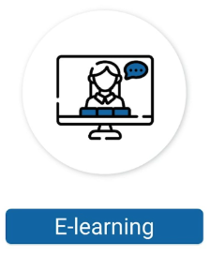
© EZ Management
ISO/IEC 27005
Information Security Risk Management
ISO/IEC 42001
AI Management System
General Data Protection Regulation (GDPR)
ISO/IEC 27002
Information Security Controls
ISO/IEC 27001
Information Security Management System
ISO/IEC 27034
Application Security
ISO/IEC 27701 Privacy Information Management System
ISO/IEC 27033
Network Security
ISO/IEC 27035
Information Security Incident Management

Slide 2
ISO/IEC 27001 Information Security Management Systems
© EZ Management
Navigating Your ISO/IEC 27001 Certification
The ISO/IEC 27001 certification represents a global benchmark in Information Security Management Systems (ISMS). This certification guides organizations in implementing a structured method for safeguarding sensitive information. It involves a comprehensive framework for pinpointing, evaluating, and addressing information security risks, crucial for maintaining the confidentiality, integrity, and availability of vital organizational data.
How Does the ISO/IEC 27001 Certification Benefit You?
Achieving the ISO/IEC 27001 certification is a testament to your dedication to information security, a critical aspect in our digitally-driven world. This certification equips you with essential skills and knowledge for proficient management and protection of sensitive organizational data. It not only elevates your professional standing but also prepares you to tackle the dynamic challenges in information security. Furthermore, being ISO/IEC 27001 certified aligns you with an international network of experts adept in upholding stringent security measures, thereby, enhancing your value in any professional setting.
Training Courses and Learning Objectives | Duration | eLearning | Self-Study
ISO/IEC 27001 Foundation Gain knowledge on the fundamental components necessary to implement and manage an ISMS based on ISO/IEC 27001 | 2 days | --- | USD 220
ISO/IEC 27001 Lead Implementer Develop the skills to support an organization in implementing and maintaining an ISMS based on ISO/IEC 27001 | 5 days | USD 610 | USD 580
ISO/IEC 27001 Lead Auditor Acquire the knowledge and skills to perform an ISMS audit by applying widely recognized audit principles, procedures, and techniques | 5 days | USD 610 | USD 580

Slide 3
ISO/IEC 27002 Information Security Controls
© EZ Management
Navigating Your ISO/IEC 27002 Certification
ISO/IEC 27002 is a globally recognized standard offering a robust guide for enhancing information security management in organizations. This standard lays out an extensive set of security controls and best practices. It encompasses various domains including risk management, compliance, formulation of security policies, training of employees, incident management, and managing supplier relations. ISO/IEC 27002 plays a pivotal role in helping organizations protect their sensitive data, comply with legal and regulatory obligations, and cultivate a strong security culture. According to the estimates of Cisco, the number of DDoS attacks will increase to 15.4 million by 2023.
How Does the ISO/IEC 27002 Certification Benefit You?
ISO/IEC 27002 training course is vital for information security professionals as it offers a globally recognized framework of security controls and best practices. This framework helps professionals protect sensitive data effectively, stay compliant with regulations, and enhance their career prospects. Adhering to ISO/IEC 27002 demonstrates expertise in information security and equips professionals to navigate evolving cyber threats with confidence. Moreover, ISO/IEC 27002 empowers professionals to navigate the complex landscape of information security with assurance, ensuring the confidentiality, integrity, and availability of critical data.
Training Courses and Learning Objectives | Duration | eLearning | Self-Study
ISO/IEC 27002 Foundation Gain knowledge on information security management practices including the selection, implementation, and management of controls based on ISO/IEC 27002 | 2 days | --- | USD 220
ISO/IEC 27002 Manager Develop the skills necessary to implement, manage, and communicate information security controls based on ISO/IEC 27002 | 3 days | --- | USD 350
ISO/IEC 27002 Lead Manager Master the concept, skills, and techniques to successfully implement and effectively manage information security controls based on ISO/IEC 27002 | 5 days | --- | USD 580

Slide 4
ISO/IEC 27005 Information Security Risk Management
© EZ Management
Navigating Your ISO/IEC 27005 Certification
ISO/IEC 27005 sets the benchmark for guidelines in information security risk management. This standard facilitates a methodical approach for organizations to identify, assess, and manage risks associated with their information assets. It guides in recognizing potential threats and vulnerabilities, alongside evaluating the possible
impacts of these risks. Additionally, ISO/IEC 27005 aids in ranking risks according to their level of significance, ensuring that the most critical issues are addressed first. A key focus of this standard is the continuous monitoring and reassessment of risk management strategies, to guarantee the efficacy of implemented security measures.
How Does the ISO/IEC 27005 Certification Benefit You?
ISO/IEC 27005 training course is very important for information security professionals. It equips professionals with the skills to identify threats, vulnerabilities, and their impacts, making informed risk mitigation decisions. Proficiency in ISO/IEC 27005 is highly valued in the cybersecurity industry, contributing to career growth by showcasing expertise in safeguarding information assets and aligning with industry standards. This standard empowers professionals to excel in the dynamic and crucial field of information security.
Training Courses and Learning Objectives | Duration | eLearning | Self-Study
ISO/IEC 27005 Foundation Gain knowledge on interpreting the guidelines of ISO/IEC 27005 in order to identify, assess, and manage information security-related risks | 2 days | --- | USD 220
ISO/IEC 27005 Risk Manager Develop the skills to carry out risk management processes related to information security assets by following the guidelines of ISO/IEC 27005 | 3 days | --- | USD 350
ISO/IEC 27005 Lead Risk Manager Acquire the expertise to support an organization in performing information security risk management processes by referring to the guidelines of ISO/IEC 27005 | 5 days | USD 610 | USD 580

Slide 5
ISO/IEC 27033 Network Security
© EZ Management
Navigating Your ISO/IEC 27033 Certification
Network Security Certification is a formal recognition of expertise in protecting computer networks and data from various types of cyber threats and vulnerabilities. Embarking on a Network Security Certification journey involves diving deep into the realm of safeguarding data and systems in networked environments. This certification path covers a comprehensive curriculum, including understanding network architectures, implementing firewalls and security protocols, intrusion detection and prevention, as well as encryption and VPNs. You will learn about the latest threats, how to counteract them, and the best practices in network security management.
How Does the ISO/IEC 27033 Certification Benefit You?
Achieving a Network Security Certification can significantly boost your career in IT and cybersecurity fields. It validates your skills and knowledge in safeguarding networks, a critical component of any
organizations’ IT infrastructure. With this certification, you become more marketable to employers, opening doors to roles such as network administrator, security analyst, or cybersecurity specialist. It also prepares you for handling complex security challenges and staying
ahead of evolving cyber threats, thereby enhancing your professional credibility and offering opportunities for career advancement and higher earning potential in the ever-growing field of network security.
Training Courses and Learning Objectives | Duration | eLearning | Self-Study
ISO/IEC 27033 Lead Network Security Manager Obtain the necessary competence to plan, implement, manage, and maintain network security based on ISO/IEC 27033 series of standards | 5 days | --- | USD 580

Slide 6
ISO/IEC 27034 Application Security
© EZ Management
Navigating Your ISO/IEC 27034 Certification
The ISO/IEC 27034 Application Security Lead Manager Certification equips professionals with advanced skills in managing application security risks, focusing on ISO/IEC 27034 standards. Pursuing the ISO/IEC 27034 Application Security Lead Manager certification entails comprehensive training in application security, including legal compliance, risk management, and security integration in the application development lifecycle. This certification process develops your ability to identify and mitigate security risks, preparing you for
leadership roles in IT security.
How Does the ISO/IEC 27034 Certification Benefit You?
Achieving the ISO/IEC 27034 Application Security Lead Manager Certification enhances your expertise in a critical IT security domain, opening advanced career opportunities in cybersecurity and risk management. With this certification, you gain the ability to shape
and influence organizational security strategies, lead complex security projects, and foster a culture of continuous improvement in application security practices. The skills and knowledge acquired through this certification not only enhance your professional profile but also contribute to the overall resilience and security posture of your organization.
Training Courses and Learning Objectives | Duration | eLearning | Self-Study
ISO/IEC 27034 Foundation Gain knowledge about the fundamental principles of application security based on ISO/IEC 27034 | 2 days
ISO/IEC 27034 Lead Implementer Acquire the skills to manage and lead an application security program in accordance with ISO/IEC 27034 | 5 days

Slide 7
ISO/IEC 27035 Information Security Incident Management
© EZ Management
Navigating Your ISO/IEC 27035 Certification
ISO/IEC 27035 is an international standard that provides guidelines for information security incident management. ISO/IEC 27035 certification is a crucial credential for professionals aiming to master the art of managing information security incidents. This certification is designed to validate and enhance your skills in effectively identifying, managing, and preventing security incidents in any organization. It focuses on equipping you with the expertise necessary to continuously improve Information Security Incident Management processes.
How Does the ISO/IEC 27035 Certification Benefit You?
This certification helps you become worldwide recognized security professionals and be capable of minimizing the effect of any incident in an organization. This certification is intended for all individuals with an interest in information technology security who are eager to learn the utmost skills and knowledge to protect their organization from security incidents and reduce business financial impacts. With your expertise and skills gained in this training course, the organization you work for will acquire the competence to evaluate cost-benefits and resource-allocation based on incident-response and management capabilities, by which it will effectively respond to information security incidents.
Training Courses and Learning Objectives | Duration | eLearning | Self-Study
ISO/IEC 27035 Foundation Gain knowledge on the main elements of implementing a Security Incident Management Plan and managing information security incidents | 2 days | --- | USD 220
ISO/IEC 27035 Lead Incident Manager ISO/IEC 27035 Lead Incident Manager Gain the skills and knowledge to support an organization in implementing and managing an Information Security Incident Management Plan in accordance with the guidelines of ISO/IEC 27035 | 5 days | --- | USD 580

Slide 8
ISO/IEC 27701 Privacy Information Management System
© EZ Management
Navigating Your ISO/IEC 27701 Certification
ISO/IEC 27701 is a global standard for privacy information management, providing guidelines for managing and protecting personal data. The journey to achieve the ISO/IEC 27701 Certification
involves a deep dive into privacy information management systems
(PIMS). This certification process encompasses learning how to establish, maintain, and continuously improve a PIMS, aligned with data protection regulations such as the GDPR. You will explore topics
such as data privacy risk assessment, data processing controls, consent management, and cross-border data transfer.
How Does the ISO/IEC 27701 Certification Benefit You?
Obtaining an ISO/IEC 27701 Certification can significantly enhance your professional standing, particularly in the fields of data protection and information security. It validates your expertise in managing and safeguarding personal data in compliance with global privacy regulations. This certification is increasingly sought after in a world where data privacy is paramount, making you an essential asset to organizations that handle sensitive personal information. It opens up opportunities for career advancement in various roles, including privacy officer, data protection manager, or compliance specialist.
Training Courses and Learning Objectives | Duration | eLearning | Self-Study
ISO/IEC 27701 Foundation Understand the fundamental concepts, principles, methods, and techniques used for the implementation and management of a PIMS | 2 days | --- | USD 220
ISO/IEC 27701 Lead Implementer Acquire the ability to support an organization in planning, implementing, managing, monitoring, and maintaining a PIMS based on ISO/IEC 27701 | 5 days | --- | USD 580
ISO/IEC 27701 Lead Auditor Develop the knowledge and skills to perform a PIMS audit based on audit best practices | 5 days | --- | USD 580

Slide 9
GDPR – Certified Data Protection Officer (CDPO)
© EZ Management
Navigating Your GDPR – CDPO Certification
The GDPR – Certified Data Protection Officer (CDPO) Certification validates expertise in data protection laws and practices under the EU General Data Protection Regulation (GDPR). Pursuing the GDPR - CDPO Certification involves a thorough exploration of GDPR’s requirements and the skills necessary to effectively manage data protection within an organization. This certification journey includes understanding the legal framework of GDPR, the rights of data subjects, the obligations of data controllers and processors, data protection impact assessments, and data breach response protocols.
How Does the GDPR – CDPO Certification Benefit You?
Obtaining the GDPR – CDPO Certification can significantly enhance your career, particularly in fields related to data privacy, legal compliance, and information management. It demonstrates your expertise in GDPR, one of the most stringent data protection laws globally, making you an invaluable asset to organizations operating within or about the EU. This certification enhances your credibility and marketability, opening up opportunities in various sectors, including tech companies, consulting firms, and public organizations. With the increasing importance of data privacy and the growing need for GDPR compliance, being a certified Data Protection Officer allows you to play a critical role in navigating the complex landscape of data protection, leading to potential career advancement and opportunities to impact significant organizational data privacy strategies.
Training Courses and Learning Objectives | Duration | eLearning | Self-Study
GDPR Foundation Learn the basic elements to implement and manage a compliance framework with regard to the protection of personal data | 2 days | --- | USD 220
GDPR – Certified Data Protection Officer Obtain the skills and knowledge necessary to lead all the processes for implementing a GDPR compliance program in an organization | 5 days | USD 610 | USD 580

Slide 10
ISO/IEC 42001 Artificial Intelligence Management System
© EZ Management
Navigating Your ISO/IEC 42001 Certification
The ISO/IEC 42001 Certification equips professionals with the expertise to manage and implement artificial intelligence systems in line with international best practices. Pursuing an ISO/IEC 42001 Certification immerses you in the complexities of AI management. This certification, ideal for those involved in developing or managing Artificial Intelligence Management Systems (AIMS), combines theoretical knowledge with practical training. It focuses on the ethical, legal, and efficient application of AI, preparing you to play a pivotal role in the evolving landscape of AI technology.
How Does the ISO/IEC 42001 Certification Benefit You?
Earning the ISO/IEC 42001 Certification enhances your credentials as an AI management expert, underscoring your commitment to responsible AI use and data security. It prepares you to effectively handle AI initiatives, ensuring ethical and efficient management of AI technologies. Additionally, this certification can open doors to advanced career opportunities, as you will be recognized for your specialized skills in a highly sought-after field. Your expertise in AI management system makes you an invaluable asset to organizations aiming to leverage AI technologies responsibly and efficiently.
Training Courses and Learning Objectives | Duration | eLearning | Self-Study
ISO/IEC 42001 Foundation Gain knowledge about the fundamental principles and concepts necessary to implement and manage an AIMS based on ISO/IEC 42001 | 2 days | --- | USD 220
ISO/IEC 42001 Lead Implementer Obtain the competencies needed to support an organization in implementing and maintaining an AIMS based on ISO/IEC 42001 | 5 days | USD 610 | USD 580
ISO/IEC 42001 Lead Auditor Acquire the knowledge and skills to perform an AIMS audit by applying widely recognized audit principles, procedures, and techniques | 5 days | USD 610 | USD 580

Slide 11
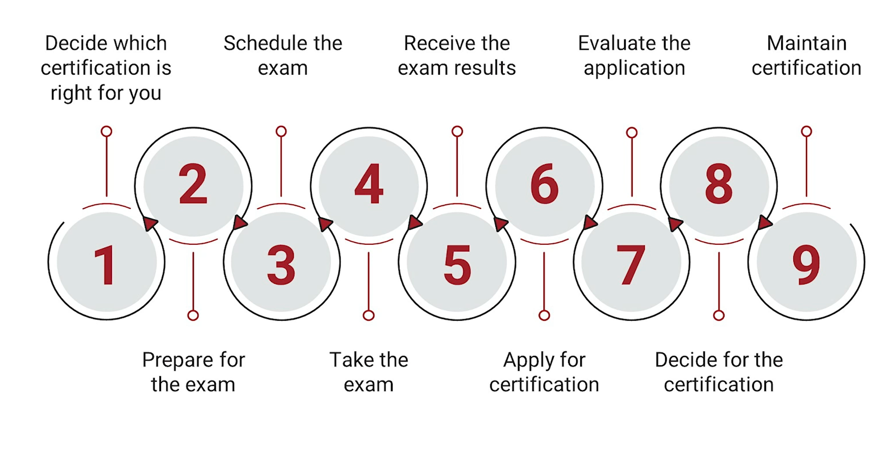
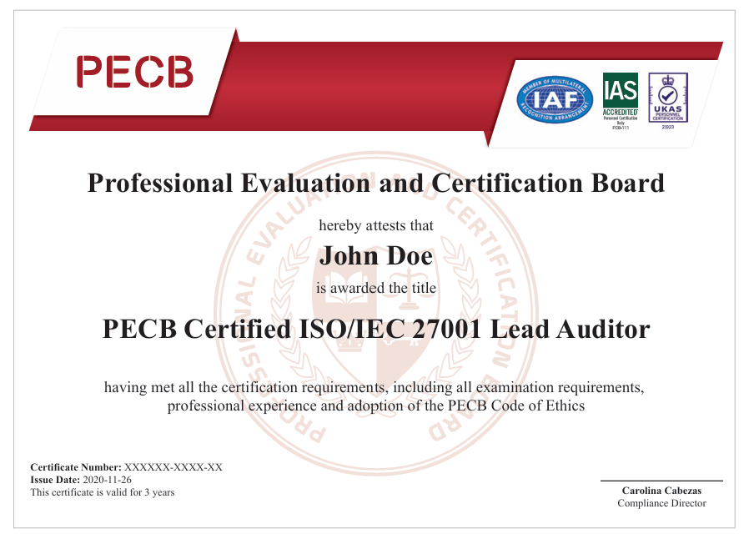
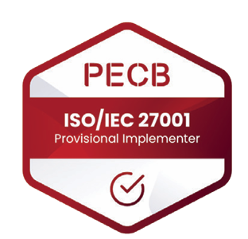
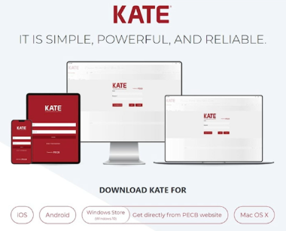
Road to Certification
© EZ Management
PECB Tools: KATE App
Maximum period for learning and applying for certification: 1 year
What’s included:
eLearning : Course Materials + Pre-recorded videos + Exam ( 2 Attempts)
Self-Study : Course Materials + Exam ( 2 Attempts)

Slide 12
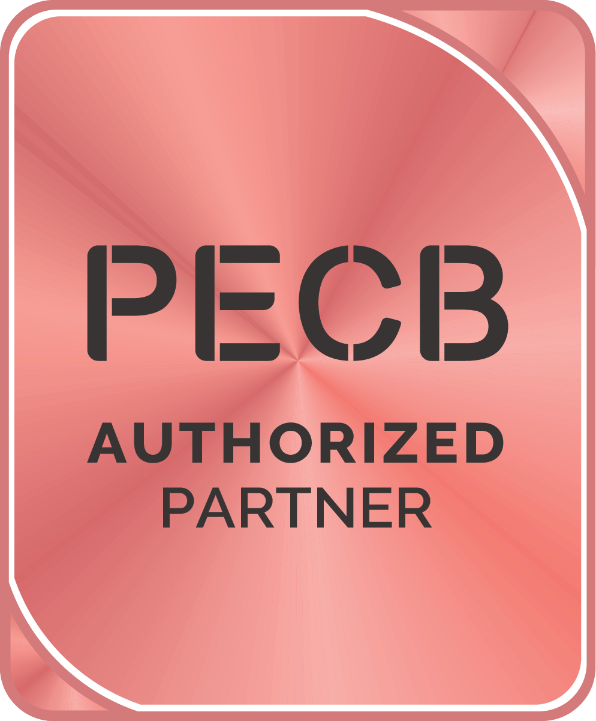
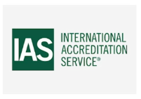
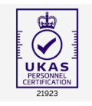
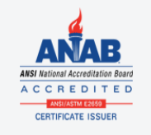
PECB Brochure link
© EZ Management
Questions? Contact Us ☺
Information Security
ISO/IEC 27001 Brochures | PECB
ISO/IEC 27002 Brochures | PECB
ISO/IEC 27005 Brochures | PECB
ISO/IEC 27034 Brochures | PECB
ISO/IEC 27035 Brochures | PECB
Privacy and Data Protection
ISO/IEC 27701 Brochures | PECB
GDPR - Data Protection Officer Brochure | PECB
Artificial Intelligence
ISO/IEC 42001 Brochures | PECB
PECB Accreditations and Affiliations
Accreditations and Affiliations | PECB
…

Slide 13
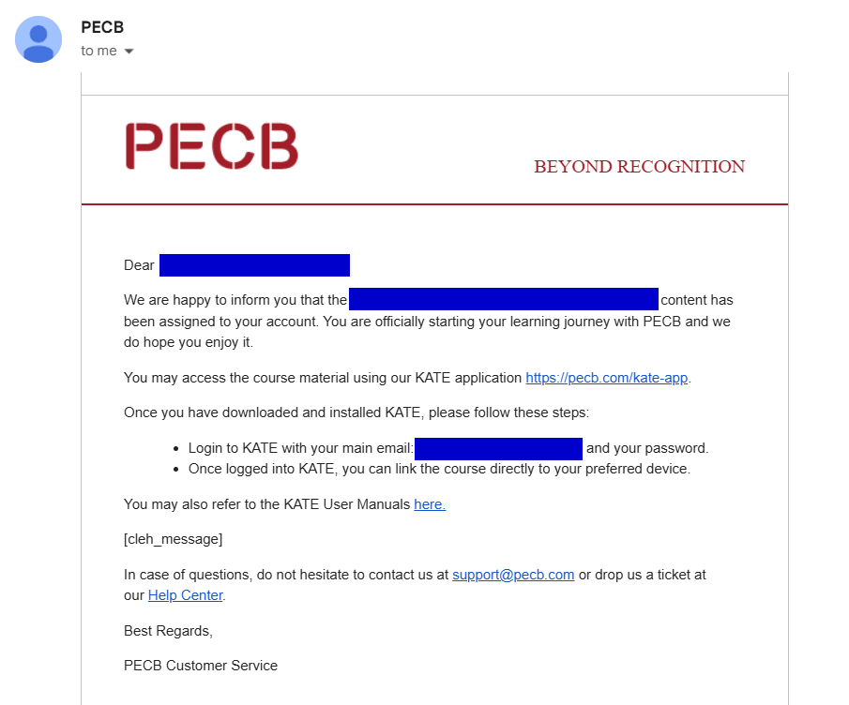
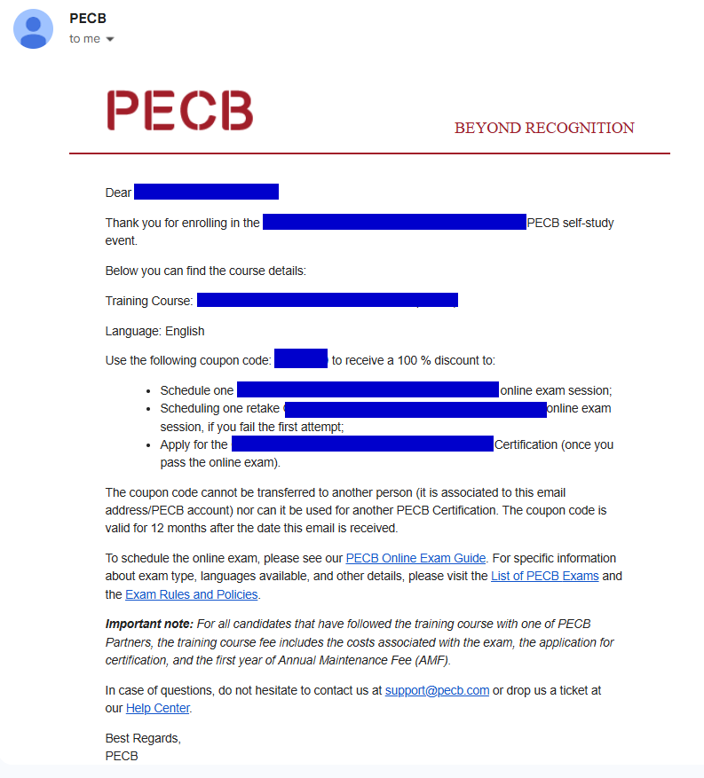
Notification Emails
© EZ Management
KATE Course content assigned
PECB course coupon code for examination and certification

